Slide 2
God, we are thankful that you call us to serve you and to reach out in love to our neighbors. Guide us, as we start to prepare for our trip. May we learn to build kindness with each other, with our neighbors and with all your people. Bless the staff at ASP who are busy preparing for a summer of service and transformation. Be with the families who are preparing to receive us into their homes. May your love and peace shine within our group that smiles turn to conversations, and strangers become friends. We pray this in Christ’s name. Amen.

Slide 3
ASP Jeopardy
There can only be one winner
.....But we all are winners in the love of Christ!

Slide 4
Game Board
 | Tex Evans Fun Facts! | All things ASP | Wild Card
 | 100 | 100 | 100
 | 200 | 200 | 200
 | 300 | 300 | 300
 | 400 | 400 | 400
Bonus

Slide 5
All things ASP-100
Who was ASP’s founder? What was his profession?
(Bonus 100 if you can recite his famous quote/ASP’s motto)

Slide 6
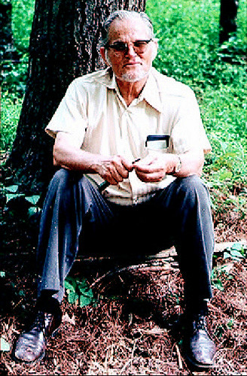
All things ASP-100 Answer
Tex Evans
Methodist Minister!
“We accept people right where they are, Just the way they are”

Slide 7
All things ASP- 200
How many Volunteers will work with ASP this summer?
Everyone submit a guess and closest wins.

Slide 8
All things ASP-200 Answer
Roughly 8,000!

Slide 9
All things ASP- 300
Where was ASP’s first ever summer center?
(Town or County)
**Bonus if you know the year

Slide 10
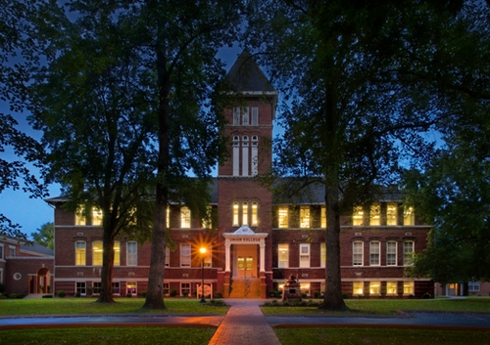
All things ASP 300-Answer
Barbourville KY!/Knox Co.
@ Union College
1969

Slide 11
All things ASP-400
How many centers will ASP operate in this summer?
(Additional 200 points if you can name the states they will be located in.)

Slide 12
ASP History 400-Answer
17 Centers!

Slide 13
Tex Evans Fun Facts-100
Where did ASP founder Tex Evans serve before he found ASP?

Slide 14
Tex Evans Fun Facts-100 Answer
Tex Evans was the Director at Henderson Settlement in Frakes, KY for 13 years.

Slide 15
Tex Evans Fun Facts-200
Where did Tex Evans complete his studies?

Slide 16
Tex Evans Fun Facts-200 Answer
Boston University School of Theology.

Slide 17
Tex Evans Fun Facts-300
How many youth did Tex Evans recruit to serve during ASP’s first summer in 1969?

Slide 18
Tex Evans Fun Facts-300 Answer
50 youth from 4 youth groups.

Slide 19
Tex Evans Fun Facts-400
Beyond his family, what were the 2 great loves that Tex embraced?

Slide 20
Tex Evans Fun Facts-400 Answer
The people of Central Appalachia and youth from churches across the country with a desire to serve.

Slide 21
Wild Card-100
Daily Double!!!!!!!

Slide 22
Daily Double Question
What is the Theme and Theme Verse for this summer and what does it say?

Slide 23
Daily Double Answer
Theme: Building Kindness
Theme verse: Ephesians 4:32
“Be kind and compassionate to one another, forgiving each other, just as in Christ, god forgave you.”

Slide 24
Wild Card-200
In the Gospel, Jesus is asked by an inquirer, what is the greatest commandment? His response is:

Slide 25
Wild Card-200 Answer
Love the lord with all your heart soul and mind, and love your neighbor as yourself.

Slide 26
Wild Card-300
How many vehicles are in ASP’s fleet?

Slide 27
Wild Card-300 Answer
ASP maintains a fleet of 150 trucks, vans and cars.
The first donated vehicle was a station wagon named Pinky.

Slide 28
Wild Card-400
How many summer centers has ASP had in the past 55 summers?

Slide 29
Wild Card-400 Answer
77 Summer centers in 5 states: Virginia, West Virginia, Tennessee, Kentucky, and North Carolina.

Slide 30
Bonus Question!
How do we solve the problem of systematic poverty in Central Appalachia and address the root causes behind it?

Slide 31
Answer…
The point of this game was to have fun, and learn a little, but to more importantly understand that poverty, although it might seem straightforward, is very complicated and a difficult problem to address.
During your summer week of service, learn, observe, get to know your homeowner, hear their stories, and get a new and very different perspective of the world.

Slide 32
Sending Prayer
Let us pray:
May God bless us with discomfort at easy answers, half-truths, and superficial relationships, so that we may live deep within our hearts.
May God bless us with anger at injustice, oppression, and exploitation of people, so that we may work for justice, freedom, and peace.
May God bless us with tears to shed for those who suffer from pain, rejection, hunger, and war, so that we may reach out our hands to comfort them and turn their pain into joy. Amen.

