Slide 1

Advancement Report
Board Meeting 2/19/26

Slide 2
LEGACY GIVING PROGRAM: The Tex Evans Society
2019 and 2020: 26 members
2021: 55 members
2022: 64 members
2023: 73 members
2024: 78 members – started using Free Will and increased promotion
2025: 100 members
2026: 104 members!!!
11 members are anonymous
Anticipated giving: $5.25 million
Goal for 2026:
15 new members
Heavy promotion post summer:
August is National Make a Will month)
October is National Planned Giving month
For our 60th year, we will do a big push for legacy giving with a major campaign to raise funds for the Endowment.

Slide 3
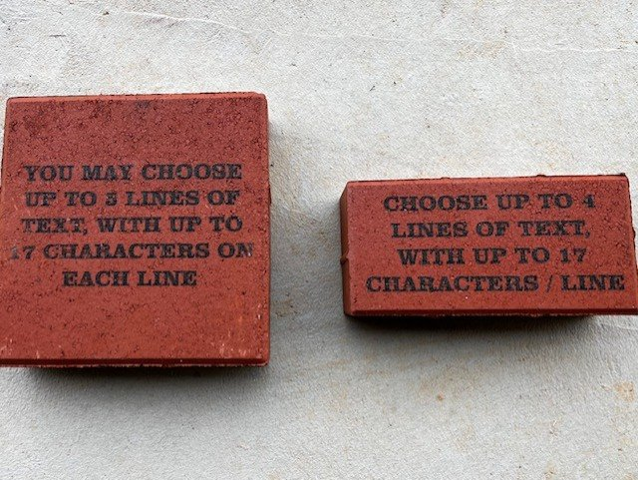


Slide 4
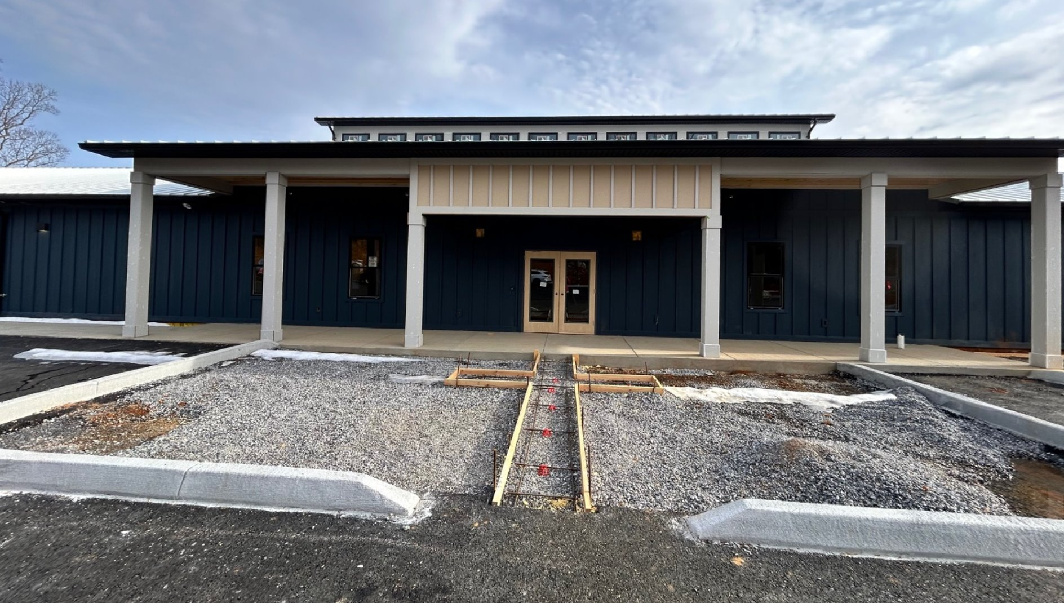
With space for 2,116 bricks to fill out the main walkway leading up to the main entrance, this is a GREAT fundraising opportunity for churches, individuals, staff or corporate partners to have a lasting part of this year-round facility.

Slide 5
Naming Opportunities for Highlands Center
Kitchen: $50,000
Conference room: $35,000
3 large dorm rooms: $25,000
Coffee station: $20,000
2 classrooms: $20,000
2 dormitory gathering spaces: $15,000
2 small sleeping rooms: $10,000
Staff office: $10,000
Staff sleeping rooms: $10,000
Furnishings: bunk beds, tables, chairs, kitchen supplies, TVs, ceiling fans, picnic tables, desks, benches, washer/dryer, and stage $1,000 - $30,000
Muddy boot area: $5,000
Rocking chairs: $350
4x8 bricks: $250
8x8 bricks: $400

